Slide 1
Logic for Neural Networks assisted by NeuroEvolution
Masters Thesis Supervisor: Nina Gierasimczuk
Abhista - s210246

Slide 2
AIM
The aim of this project is to be able to provide explanation for all neural networks with propositional logic.
The project tries to combine 2 existing methodologies, LEN(Logic Explained Networks) and NEAT(Neuroevolution of augmenting topologies) in an efficient way.
This project was proposed because LENs have a final step called pruning which when performed with the backpropagation algorithm reduces the size of the explanations by removing certain nodes and connections.
Since NEAT provides a method to grow neural network architectures, we can use NEAT to provide an optimal architecture and hence the pruning step can be avoided while keeping clarity of explanations.

Slide 3
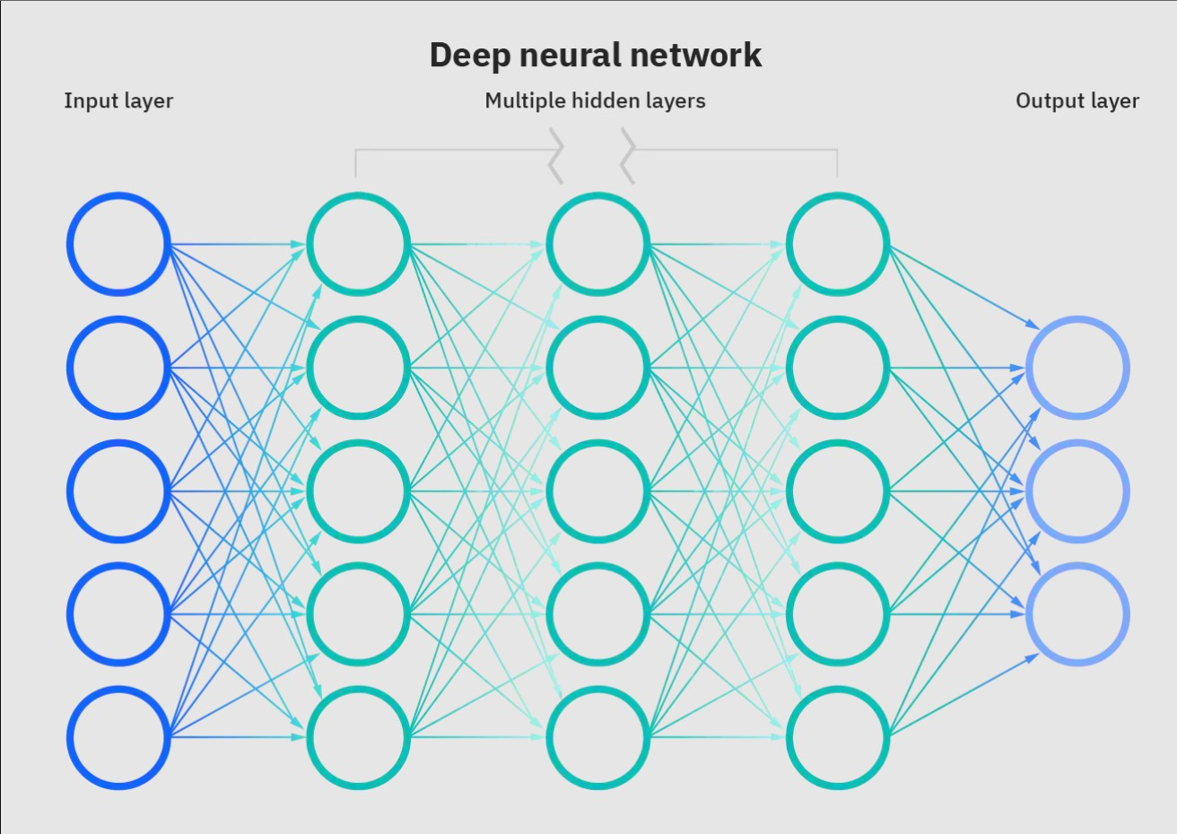
What are Neural Networks?
Neural Networks are mathematical models that act as function approximators.
They take a large input of data and map them to an output based on provided targets.
A neural networks basic compute unit is called as a perceptron.
Many perceptrons put together create a neural network.

Slide 4

Logic Explained Networks
They provide a unique way to interpret neural network approximations using propositional logic.
They convert inputs into boolean (True or False) and use these as inputs to the neural network model with the same targets.
The main bottleneck for this framework is that the inputs and outputs should be human understandable or boolean.
If the above condition is satisfied we can use the Bi-implication cross entropy loss as shown instead of usual MSE loss used in neural networks.

Slide 5
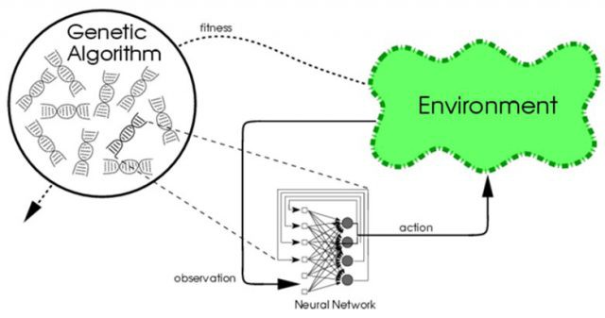
NEAT - Neuroevolution of Augmenting Topologies
NEAT is a genetic algorithm that is used to develop/improve neural network models. In other words it is an optimization algorithm for neural networks.
It is a powerful algorithm for training neural networks as it allows for changing the network topology dynamically within the algorithm.
It is a popular method used to solve Reinforcement learning problems.

Slide 6

Reinforcement Learning
Reinforcement learning is a method of machine learning in which the AI agent learns by trial and error.
The AI agent is set to perform a some action and everytime a correct action is taken by the agent it is rewarded and similarly penalized when an incorrect/harmful action is taken.
The agent is provided a policy that it should maximize.
Therefore, over a certain amount of iterations the AI agent learns to maximize its reward thus learning how to perform well in a provided environment.

Slide 7
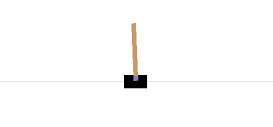
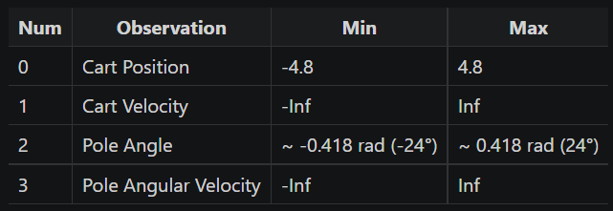
CartPole - V1
In this experiment we use the OpenAI gym environments classic control toolkits CARTPOLE V1 environment.
In this environment the objective of the agent is to balance a pole on a cart provided the observation vector as shown below.
The agent can perform two actions. (0 to go left or 1 to go right).
The agent is rewarded 1 point for every frame it keeps the pole upright.

Slide 8
NEAT config file
Since we know NEAT can solve this problem easily we use the parameters used to solve this as a baseline for all the experiments run in the future.
Config :-
Population size: 150
Max Generations: 50
Speciation threshold: 3.0
Connection mutation rate: 0.8
Connection Perturbation rate: 0.9
Node addition mutation rate: 0.03
Connection addition mutation rate: 0.5
Crossover re-enable rate = 0.25
Networks saved: 0.8

Slide 9
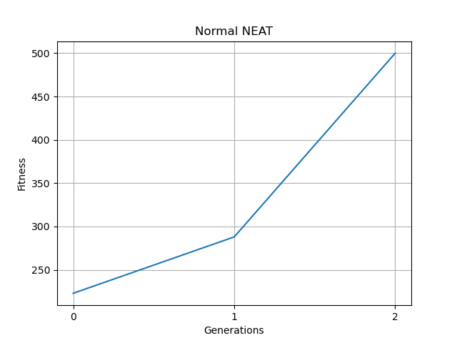
NEAT Results
As expected NEAT is really efficient at solving the problem.
The algorithm is completed in just 2 generations.
Here reaching 500 frames is considered a completed task.

Slide 10
Combining NEAT with LEN
This can be done by changing the fitness function of the genetic algorithm.
The fitness function can be changed such that the bi-directional cross entropy function can be used as an additional reward for the NEAT algorithm.
For extracting information we will need to ensure that the inputs are booleanized.
Once combined since the neural network is forced to learn connections with the bi-directional cross entropy loss, we can extract logical conclusions from the nodes of the neural network.
The reward function is now modified to providing a reward for each frame plus an extra reward for adhering to the bi-directional cross entropy function.
2 major problems when combining with the mentioned method

Slide 11
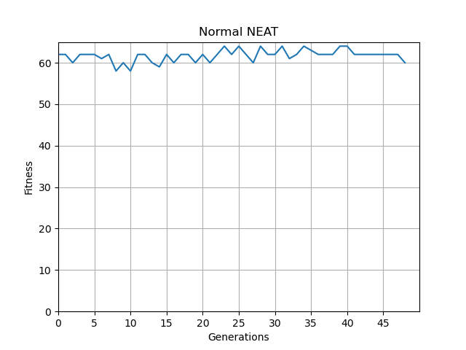
NEAT combined with LEN V1 results
Here we see that the Neural network struggles to perform the task.
The algorithm oscillates between a reward of 60 and 65. The expected maximum reward with this method is 1000.
The algorithm struggles to learn any beneficial patterns to solve the problem.
The algorithm is run for 50 generations and shows no improvements even after having 32 new nodes in the neural network.
NEAT with LEN V1

Slide 12
Problems
Boolinizing data:
If the network was booleanized before training, the network struggles to learn any significant patterns in the data.
Predictions:
The bi-directional cross entropy function requires a target so as to make associations for explanation.
This was solved by using the Normal NEAT trained to solve for the same environment as the ground truth for the new explainable model.

Slide 13
Partial Booleanization
Since booleanizing the data causes the network to perform badly, what if we split the data into the required buckets and still keep the information.
That is split the data into its boolean buckets but do not force the data to be equal to 0 or 1, instead force the value to equal 0 or a real number while predictions.
Whereas while extracting logic use these buckets as propositions.

Slide 14
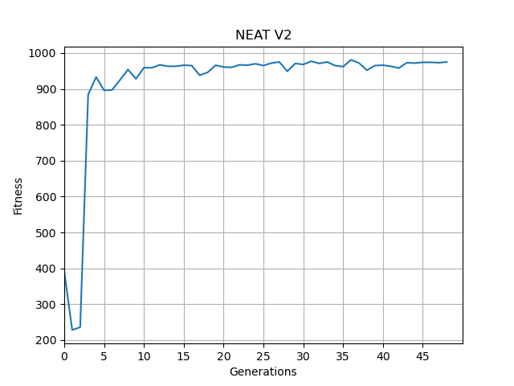
NEAT combined with LEN V2
Here, we see a drastic improvement in the performance of the network.
We see that similar to NEAT the network in generation 4 gets a reward of 920 which is very close to the max reward of 1000.
The learning algorithm stagnates within 20 generations and flatlines towards 962 and does not improve much after.
In this version of the network input we only partially booleanize the inputs and see such drastic changes/improvements in the performance of the network.
All the NEAT config parameters remain the same as initial NEAT.
Also, we see that the network has a 92.4% accuracy in explaining the output.
Notes:
Talk about the major drawbacks.

Slide 15
Work to be done:
Extracting explanations from these trained networks to see their logical explanations.
Extracting the various visualizations to show how various config parameters of the NEAT algorithm affect the explanations.
Creating a framework so this method can be generalized to other problems and not just reinforcement learning.

Slide 16
Thank You

